Slide 1

Database Systems
Course Code: CS-213
Credit Hours: 4(3-1)
Muhammad Ejaz Bashir
Lecturer
Department of Computer Sciences

Slide 2
Content of Lecture
Introduction
General Database Administration
Database Security
Database Backup
Database Replication

Slide 3
INTRODUCTION
A database designer is responsible for the design of the database system
Responsibilities:
  Data modelling using EER diagram
  Relational database design and normalization

Slide 4
INTRODUCTION
A database administrator (DBA) is responsible for managing the DBMS.
This ensures that the database system is functioning properly at all times.

Slide 5
General Database Administration
A DBA is responsible for
Server startup, shutdown and upgrade
User account maintenance
Log maintenance
Server configuration and tuning
Multiple server management

Slide 6

General Database Administration
Server startup, shutdown and upgrade
A server may freeze, hang or even crashes
A DBA therefore needs to be able to startup and shutdown the DBMS as the need arises

Slide 7
General Database Administration
Server startup, shutdown and upgrade
When a new version of DBMS is released, a DBA needs to be able to weigh the cost vs. the benefit of performing a DBMS upgrade

Slide 8
General Database Administration
User account maintenance
A DBA should allocate user accounts for each database system user. Doing so would allow us to
  Keep track of account user’s activity
  Restrict data access by account user

Slide 9




General Database Administration
Log maintenance
A log is basically a file (or several files) that is maintained by the server on the actions that have occurred so far on the server
A DBA should know which DBMS logs are important to keep and which are not
If a log is no longer needed (e.g. it records actions from 10 years ago), it should be deleted to save disk space
Figure 07

Slide 10

General Database Administration
Server configuration and tuning
A DBMS can only perform at its best through careful configuration and tuning
  As a DBA, your responsibility is to decide
    Is more memory needed?
    Is faster disk needed?
    Should we optimize for INSERT or SELECT?
    …

Slide 11


General Database Administration
Multiple server management
Database Servers
Know how to setup and manage multiple database servers
DBA

Slide 12
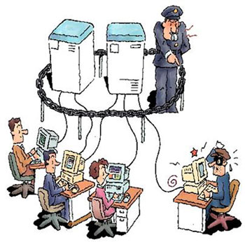


Database Security
A DBA is in charge of the security of the database system
Two security areas that a DBA should worry about are
File system Security
Database Server Security

Slide 13

Database Security
File system Security
A database system stores all of its data in regular computer files
To break security, all one needs to do is to copy all of the files to an external storage device (e.g. pen drive).

Slide 14
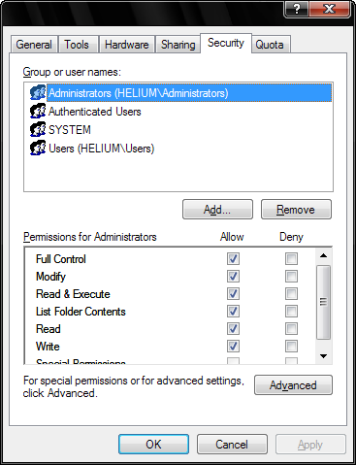
Database Security
File system Security
As a DBA, you must enforce filesystem security by limiting access to the data files
For example
Set the permissions so that only DBAs and nobody else have access to the folder containing the data files

Slide 15
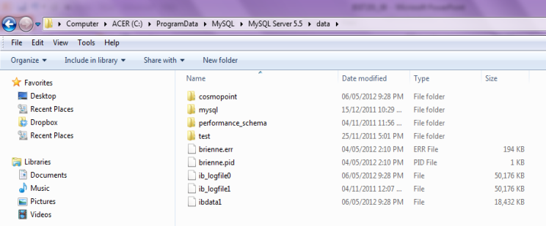
Database Security
File system Security
On Windows, the MySQL Community Server typically stores the data files in the folder
C:\ProgramData\MySQL\MySQL Server 5.5\data
Each folder is a database. In each folder, MySQL stores the database’s tables and data

Slide 16
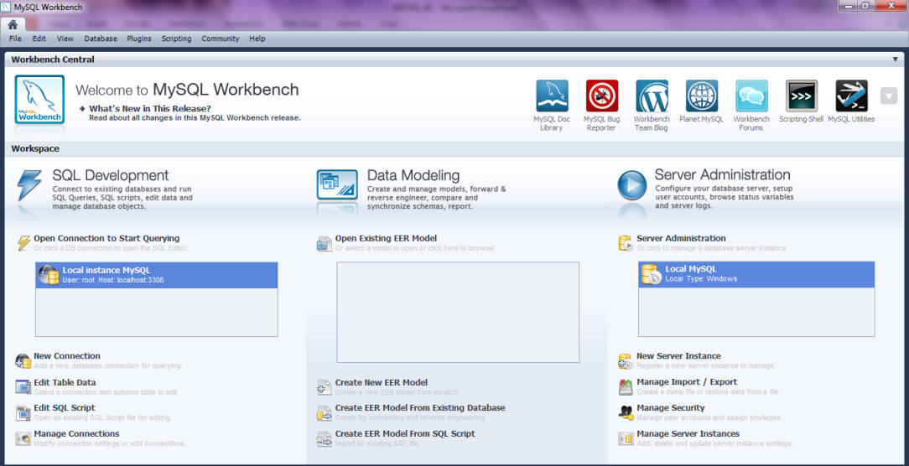
Database Security
Database Server Security
A DBA can enforce database server security through the setup of user accounts
MySQL Workbench provides a point-and-click interface for the setting up of user accounts
Double click here to access MySQL Workbench’s database administration functionalities

Slide 17
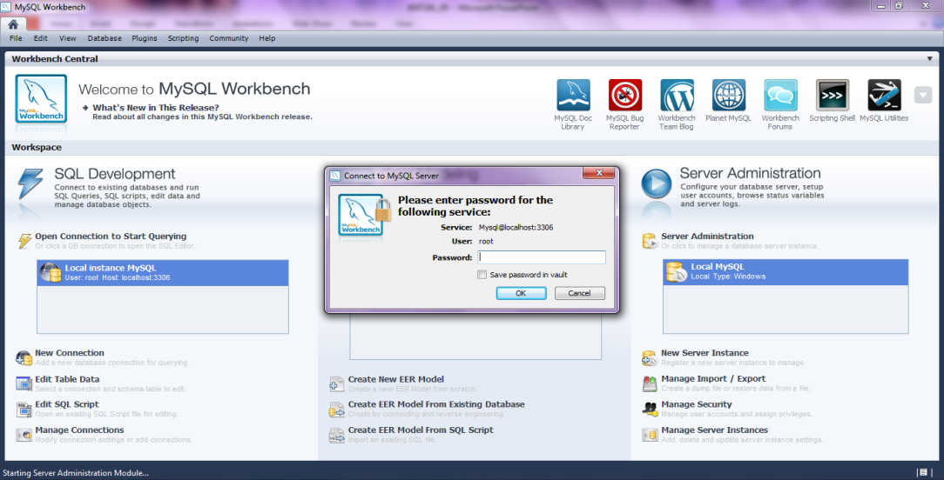
Database Security
Database Server Security
MySQL Workbench provides a point-and-click interface for database administration
Enter your password for MySQL

Slide 18
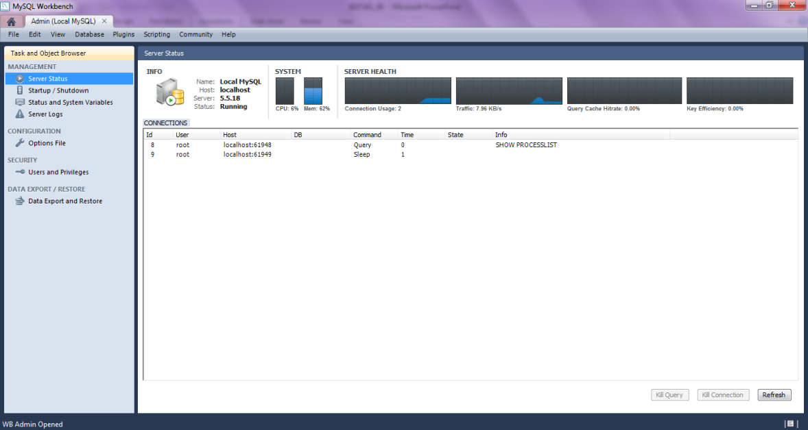
Database Security
Database Server Security
Database administration main screen
Click on “Users and Privileges” to access MySQL’s security features

Slide 19
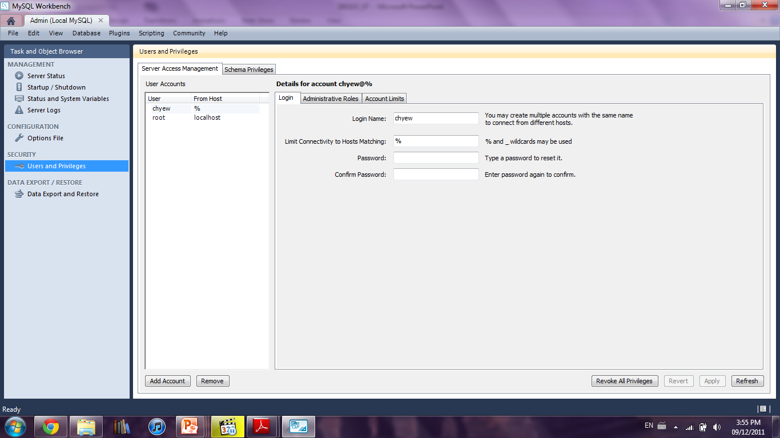
Database Security
Database Server Security
“Server Access Management” screen
Limit MySQL access to only certain computers (e.g. only office computers can access MySQL)
You can create new user account
Figure 13

Slide 20
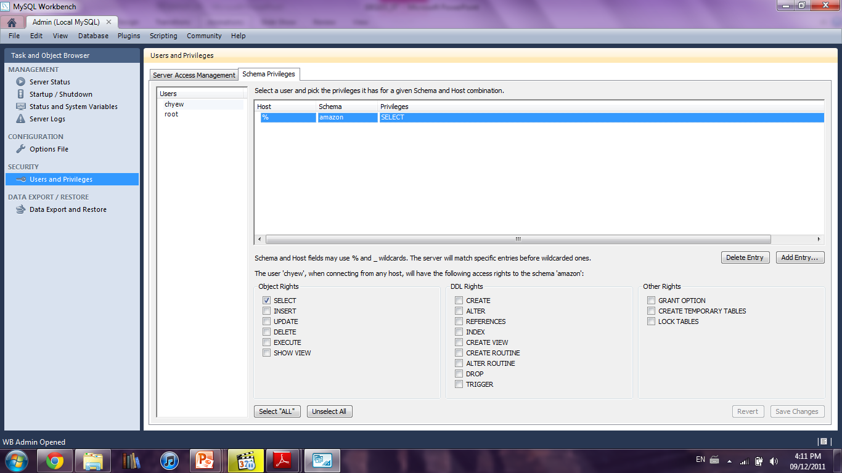
Database Security
Database Server Security
“Schema Privileges” screen
Configure which database each user can access
Configure the SQL that each user can execute

Slide 21
Database Security
Database Server Security
What about the “root” user account that we have been using so far to login to MySQL?
A root account is a special user account that is automatically created for you during MySQL installation
  It is the most privileged account as there is no restriction placed on the account
  You should use the root account to create more restricted user accounts for daily use
Figure 13

Slide 22


Database Backup
Database backup is the process of making a complete secondary copy of a database for the purpose of recovering the database following a disaster
As a DBA, you should know the two forms of backup
Binary Backup
Text-Format Backup

Slide 23
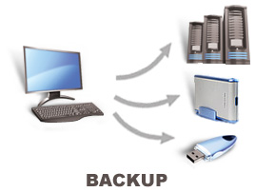
Database Backup
Binary Backup
Binary backup involves the copying of the data files of the database to one or more data repositories for safe keeping

Slide 24

Database Backup
Binary Backup
When disaster struck and data is lost, a DBA can then restore the lost data by replacing the database files with the previously backup files

Slide 25

Database Backup
Text-Format Backup
Text-format backup involves the creation of backup files that contain SQL on how to recreate databases, tables and data
CREATE DATABASE IF NOT EXISTS `amazon`
USE `amazon`;
DROP TABLE IF EXISTS `book`;
CREATE TABLE `book` (
`ISBN` int(11) NOT NULL PRIMARY KEY,
`Title` varchar(100) DEFAULT NULL,
`Quantity` int(11) DEFAULT '10',
) ENGINE=InnoDB DEFAULT CHARSET=latin1;
…

Slide 26
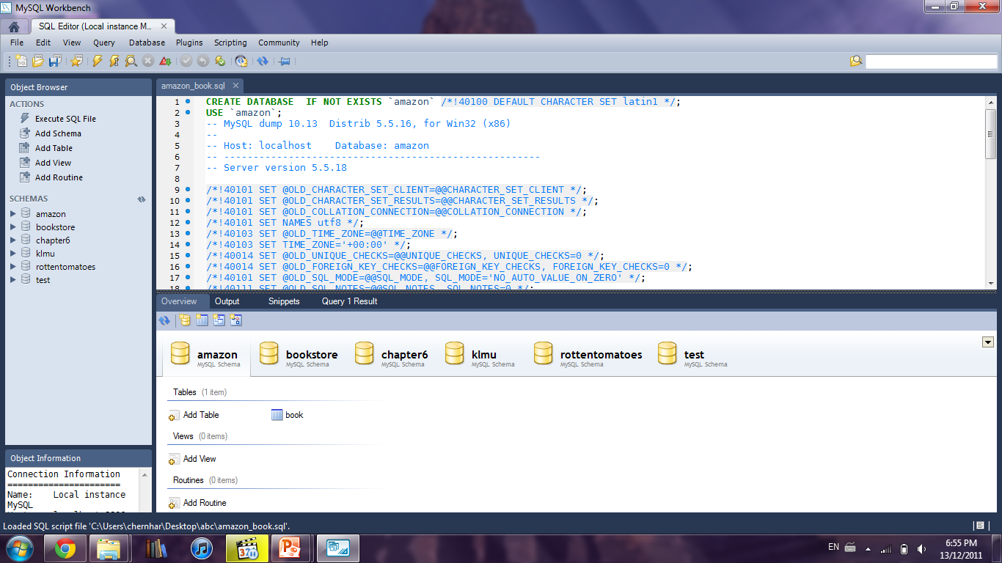
Database Backup
Text-Format Backup
When disaster struck and data is lost, a DBA can then restore the lost data by executing the SQL in the backup files
SQL from backup file
Execute the SQL to restore loss data

Slide 27
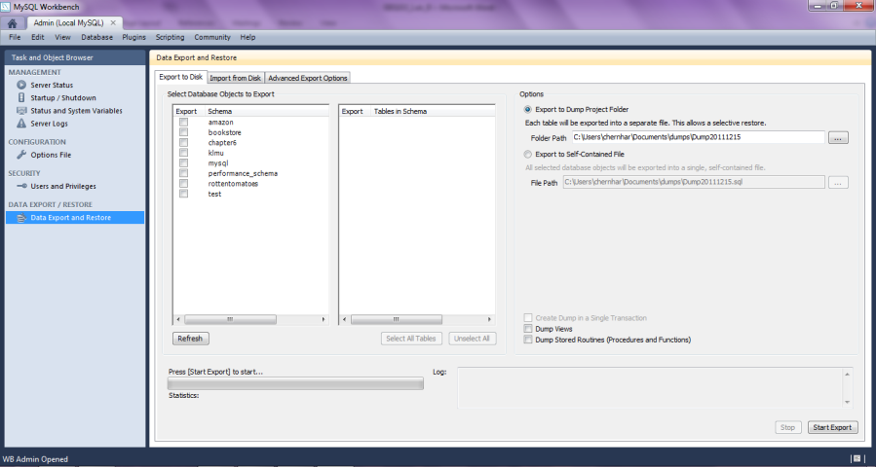
Database Backup
Text-Format Backup
In MySQL Workbench, you can perform text-format backup by accessing “Data Export and Restore”
Select database to backup
Select tables within a database to backup
Start backup

Slide 28
Database Backup
Comparison between binary backup and text-format backup
 | Binary Backup | Text-Format Backup
Backup | Copying of data files | Creation of SQL files
Restore | Copying of data files | Execute the SQL in the backup files
Speed | Fast (All one is doing is file copy) | Slow (Generating SQL, not suitable for large database)
Database server shutdown | Often required (Copying database files while the files are being updated by DBMS may corrupt the database’s data) | Not required

Slide 29
Database Replication
Database replication is a way to ensure data consistency among many database servers (i.e. servers should eventually store the same data)
Master server
With database replication, a DBA needs to setup one of the many database servers as the master server

Slide 30
Database Replication
Database replication is a way to ensure data consistency among many database servers (i.e. all servers should eventually store the same data)
Slave server
Master server
Slave server
The DBA should then setup the rest of the database servers as slave servers

Slide 31
Database Replication
Database replication is a way to ensure data consistency among many database servers (i.e. all servers should eventually store the same data)
Slave server
Master server
Slave server
The way database replication works is for all data insert/update/delete to always go through the master server

Slide 32
Database Replication
Database replication is a way to ensure data consistency among many database servers (i.e. all servers should eventually store the same data)
Slave server
Master server
Slave server
After the master server has updated its database, it would then propagate the update to the slave servers

Slide 33
Database Replication
Database replication is a way to ensure data consistency among many database servers (i.e. all servers should eventually store the same data)
Slave server
Master server
Slave server
The slave servers would then update their database and now all the database servers would store the same data

Slide 34
Database Replication
Database replication is a way to ensure data consistency among many database servers (i.e. all servers should eventually store the same data)
Slave server
Master server
Slave server
As for displaying data, you can display data from either master or slaves. Sometimes, you may display outdated data if a slave has not received its update from the master

Slide 35
Database Replication
Why database replication?
Scenario: Suppose there is a network failure and the data are no longer consistent among servers
No master-slaves
6 employees
5 employees
7 employees
No way to tell which server contains latest data

Slide 36
Database Replication
Why database replication?
Scenario: Suppose there is a network failure and the data are no longer consistent among servers
Master-slaves
6 employees
Slave server
5 employees
Master server
Slave server
7 employees
The master server would contain the latest data since we always write to the master server first

Slide 37
Database Replication
Why database replication?
Scenario: Suppose there is a network failure and the data are no longer consistent among servers
Master-slaves
6 employees
Slave server
6 employees
Master server
Slave server
6 employees
To fix the data inconsistency, all the slave servers need to do is to update its database based on that of the master

Slide 38
Database Replication
Advantages of database replication
Improve Availability
Improve Performance
Local Database Access
Backup without Lost of Database Access

Slide 39

Database Replication
Improve Availability
With one database server, if it crashes, you end up losing access to all of your data
With database replication
Slave server
Master server
Slave server
If a slave server crashes

Slide 40

Database Replication
Improve Availability
With one database server, if it crashes, you end up losing access to all of your data
With database replication
Crashed server
Master server
Slave server
The other servers would keep functioning

Slide 41
Database Replication
Improve Availability
With one database server, if it crashes, you end up losing access to all of your data
With database replication
Slave server
Master server
Slave server
Upon slave server recovery, it would simply get its updates from the master

Slide 42

Database Replication
Improve Availability
With one database server, if it crashes, you end up losing access to all of your data
With database replication
Slave server
Master server
Slave server
If the master server crashes

Slide 43

Database Replication
Improve Availability
With one database server, if it crashes, you end up losing access to all of your data
With database replication
Slave server
Crashed server
Master server
Choose a new master server from among the slaves and continue on

Slide 44
Database Replication
Improve Performance
As there are now multiple database servers, any request to display data can now be executed on the “best” server
Busy
Busy
Busy
Free
Busy
Displaying data from the free server should be faster since it is not busy. This is not possible if we only have one database server

Slide 45



Database Replication
Local Database Access
A slave database server can be placed anywhere in the world
For example
Master server
Displaying data through such long distance can be slow

Slide 46
Database Replication
Local Database Access
A slave database server can be placed anywhere in the world
For example
Master server
Master server updates slave server with latest data
Slave server
Displaying data in China through the slave server is faster since it is local

Slide 47
Database Replication
Backup without Lost of Database Access
Binary backup often means the lost of data access as the server needs to be shut down
With database replication
Slave server
Performing binary backup…
Master server
Slave server
Shutdown one slave server to perform binary backup. Data access not affected

Slide 48
SUMMARY
A database designer is responsible for data modelling, database design and normalization
A database administrator is responsible for the management of the DBMS (i.e. making sure that the DBMS is functioning properly at all times)
General database administration
  Server startup, shutdown and upgrade
  User account maintenance
  Log maintenance
  Server configuration and tuning
  Multiple server management
Database security
  Filesystem security
  Database server security

Slide 49
SUMMARY
Database backup
  Binary backup
  Text-format backup
Database replication
  One master server and one or more slave servers
  Master server is responsible for ensuring that eventually all the slave servers will have the same data in their databases as that of the master
  Advantages
    Improve availability
    Improve performance
    Local database access
    Backup without lost of database access

Slide 50



